Slide 1
How To Put Data Science and Machine Learning to work - for you !
Results FROM Analyzing 11.5 million rows of taxi trip data

Slide 2
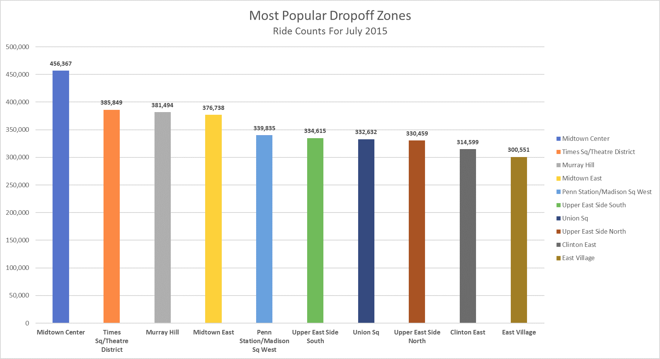
1. Tourist / resident perspective
Question:
Which are the most popular destinations in New York City overall?
Answer:
Midtown Center (overall), followed by Times Sq and Murray Hill
Link: Excel Workbook With Pivot Table and Charts

Slide 3
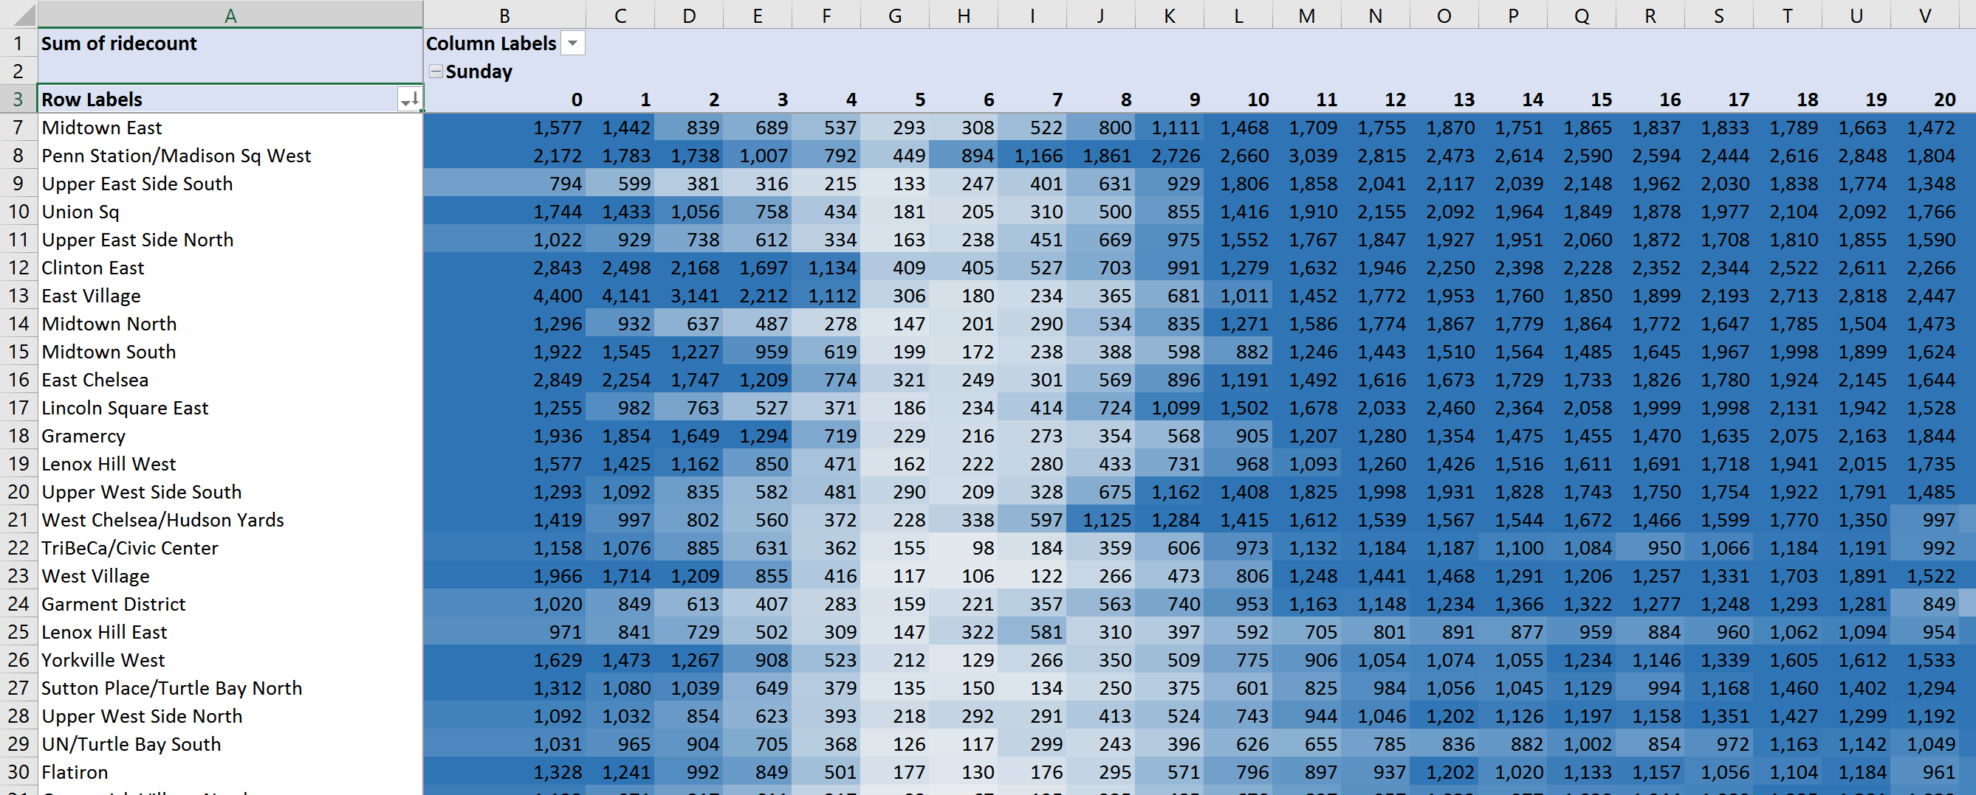
1. Tourist / resident perspective
Question:
Which are the most popular destinations in New York City at various times of the day/night/weekend?
Answer:
Explore this pivot table to see which areas are active during specific times
Link: Excel Workbook With Pivot Table and Charts

Slide 4
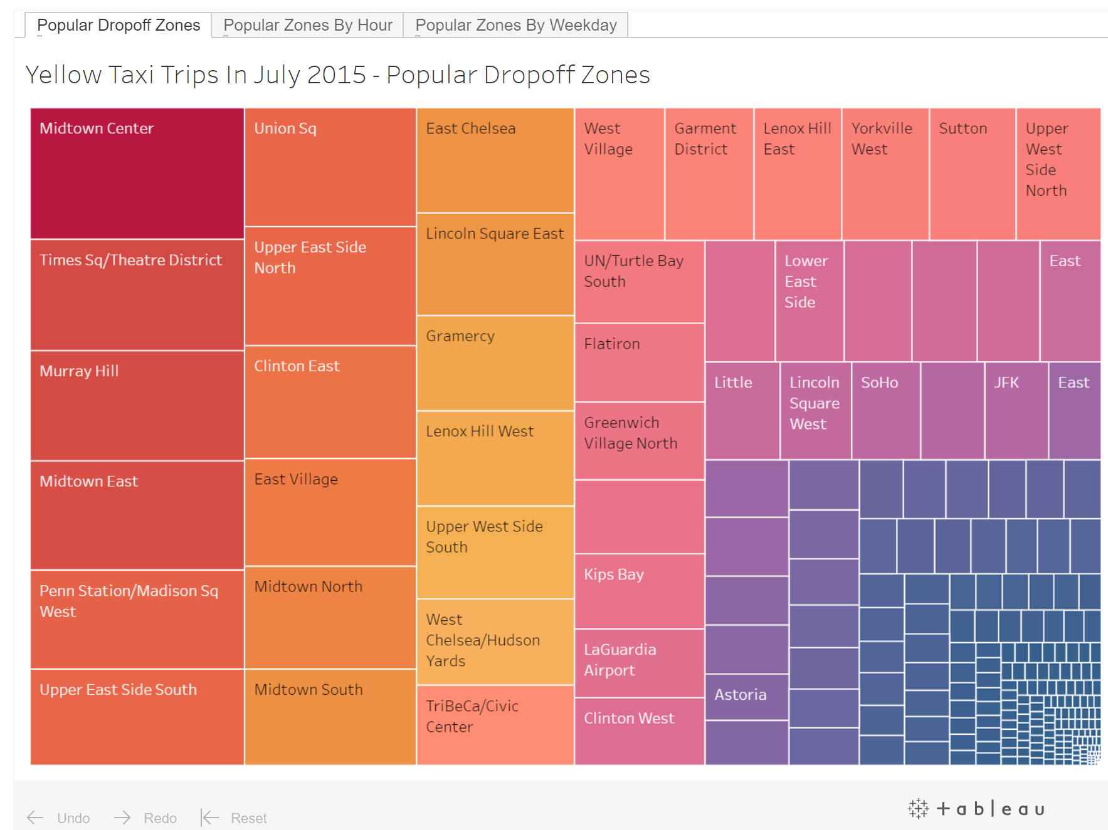
1. Tourist / resident perspective
Question:
Which are the most popular destinations in New York City overall?
Answer:
Explore the interactive visualization for details
Link: Tableau (Interactive)

Slide 5
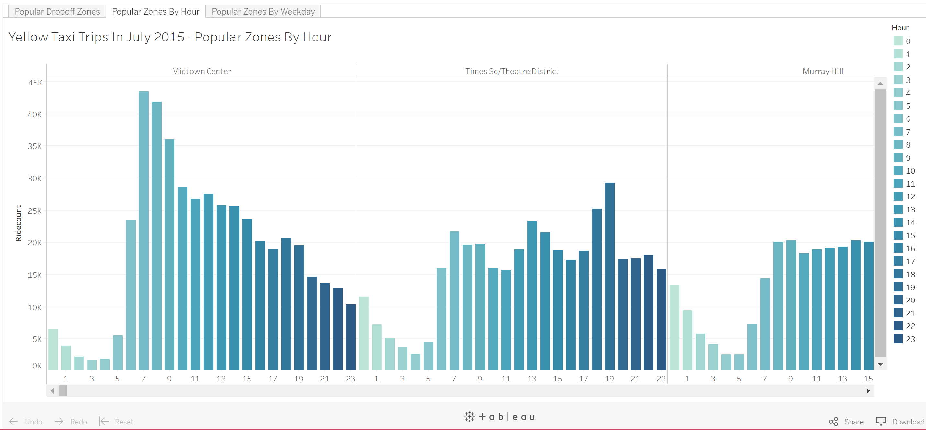
1. Tourist / resident perspective
Question:
Which are the most popular destinations in New York City at various times of the day/night/weekend?
Answer:
Explore this visualization for details
Link: Tableau (Interactive)

Slide 6
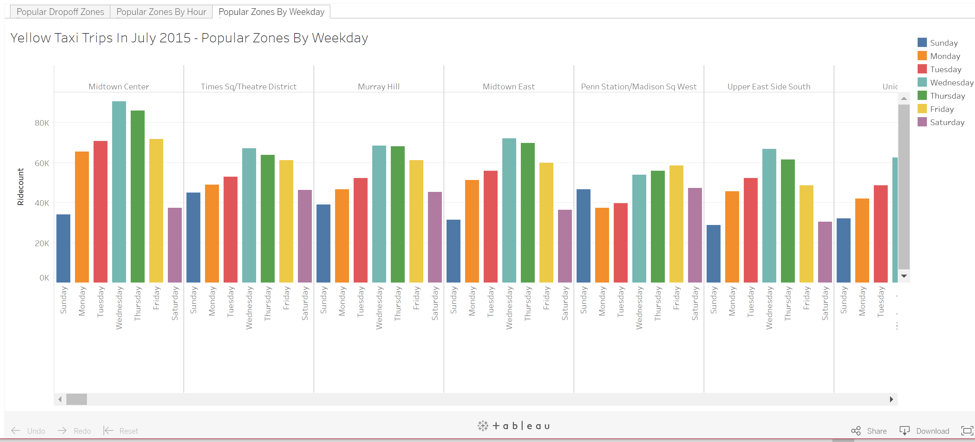
1. Tourist / resident perspective
Question:
Which are the most popular destinations in New York City at various times of the day/night/weekend?
Answer:
Explore this visualization for more details
Link: Tableau (Interactive)

Slide 7
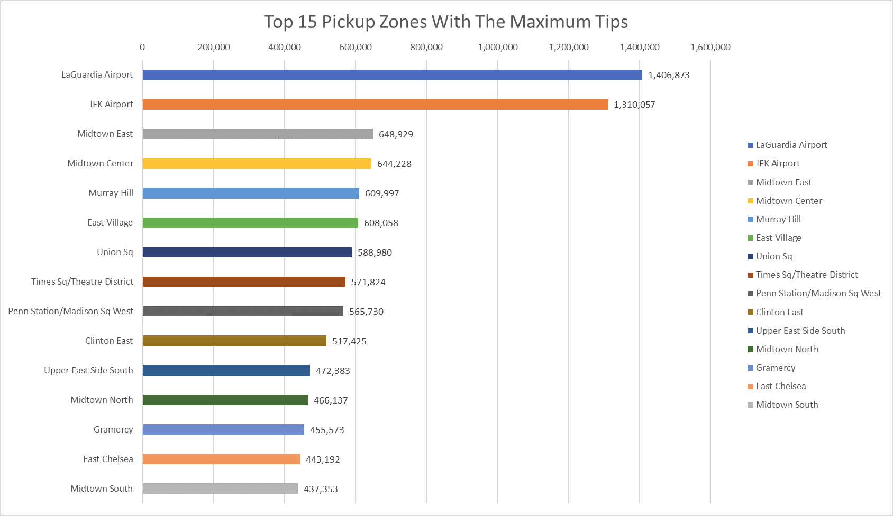
2. Cab Driver perspective
Question:
Where should I go to pick up passengers to earn the maximum tips?
Answer:
LaGuardia Airport, followed by JFK Airport and Midtown East
Link: Excel Workbook With Pivot Table and Charts

Slide 8
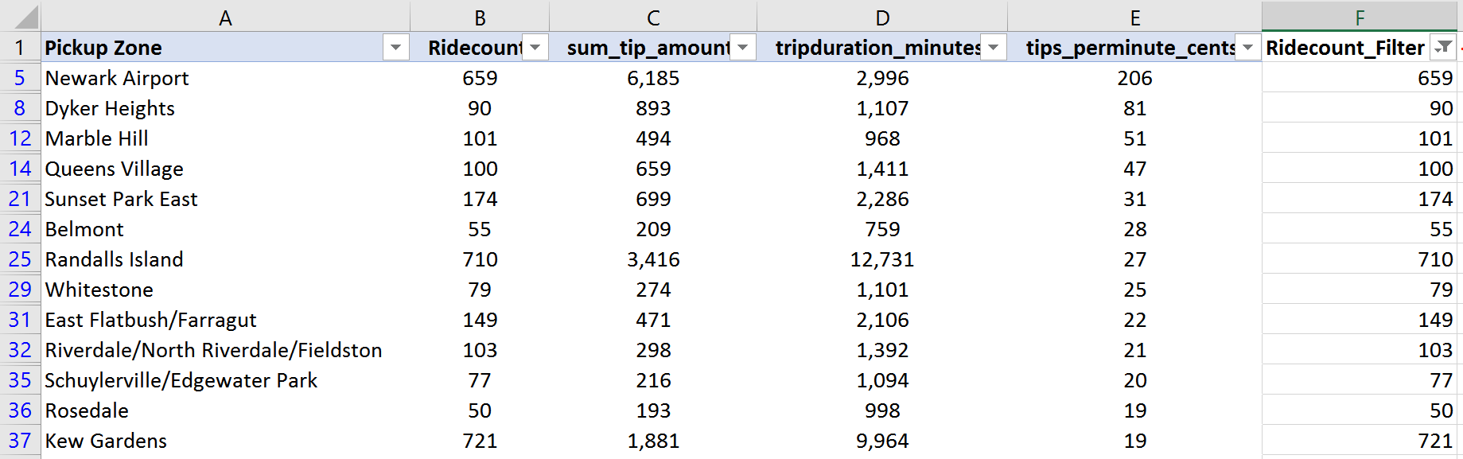
2. Cab Driver perspective
Question:
Where should I go to pick up passengers to earn the maximum tips per minute (best ROI of driver’s time)?
Answer:
If you look at tips per minute, Newark Airport is at the top of the list
Link: Excel Workbook With Pivot Table and Charts

Slide 9
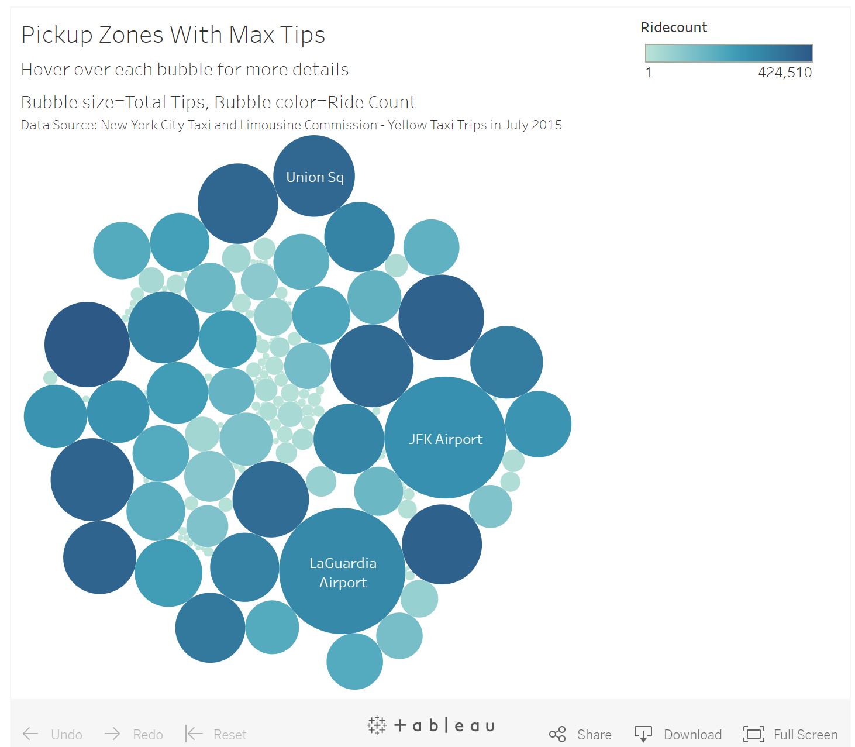
2. Cab Driver perspective
Question:
Where should I go to pick up passengers to earn the maximum tips?
Answer:
Explore this visualization for details
Link: Tableau (Interactive)

Slide 10
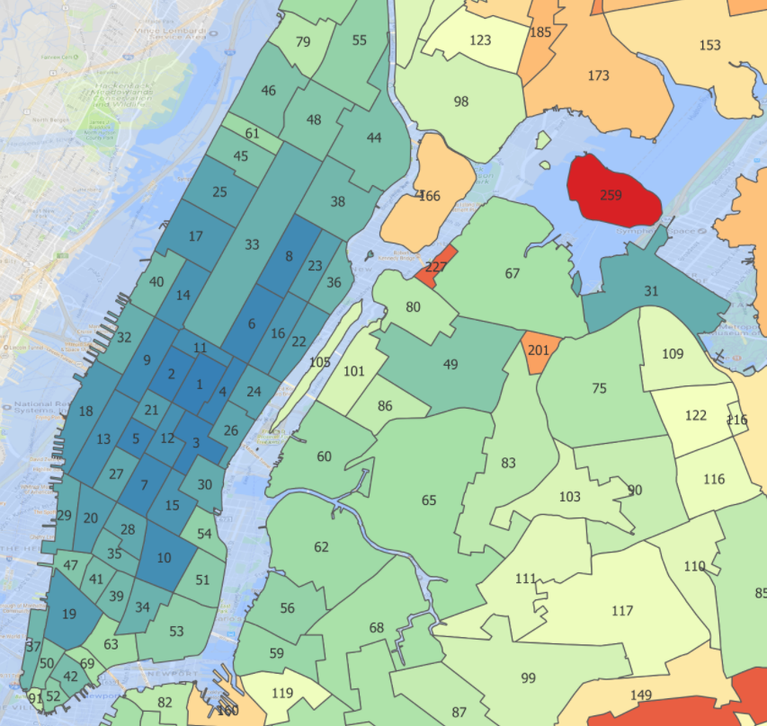
3. Business Owner perspective
Question:
What is the ideal location to open a retail store based on traffic patterns?
Answer:
Top 4 neighborhoods are in Midtown: Midtown Center, Times Sq, Murray Hill, Midtown East
Link: Interactive Map in QGIS Cloud

Slide 11
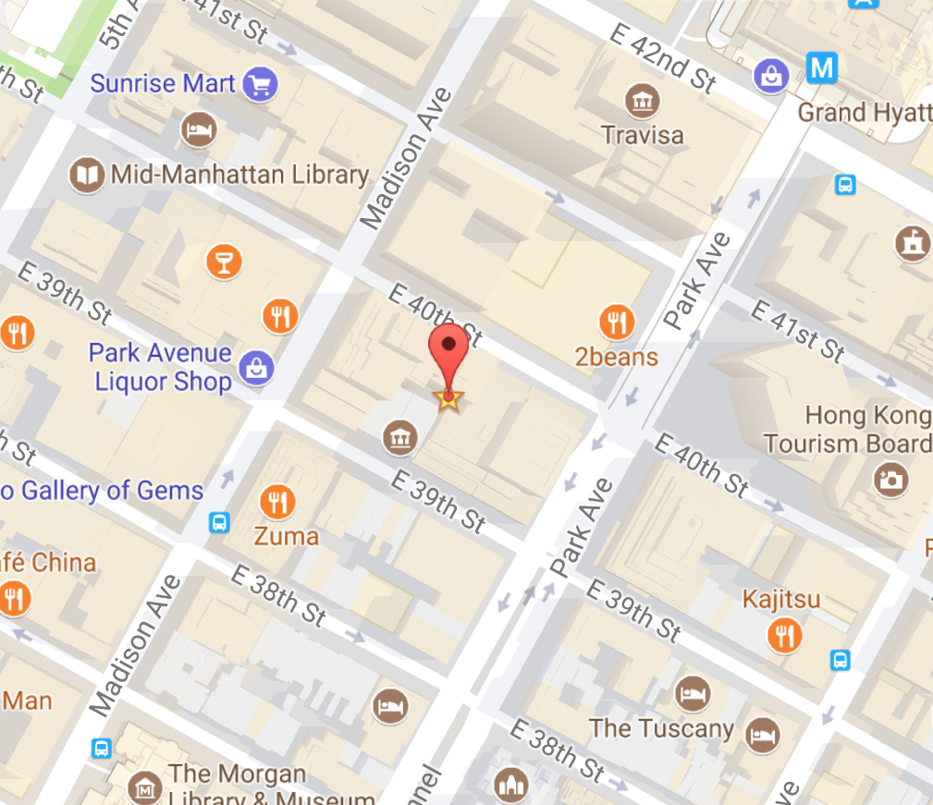
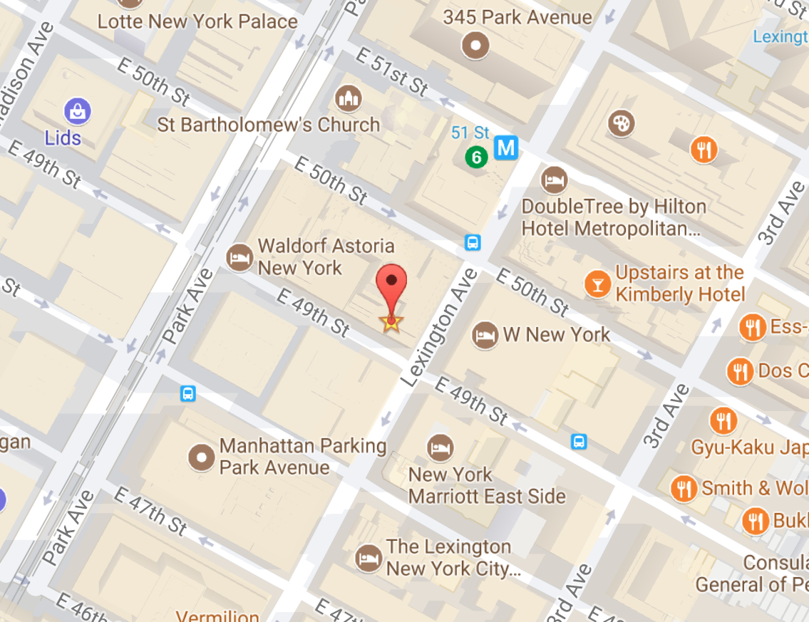
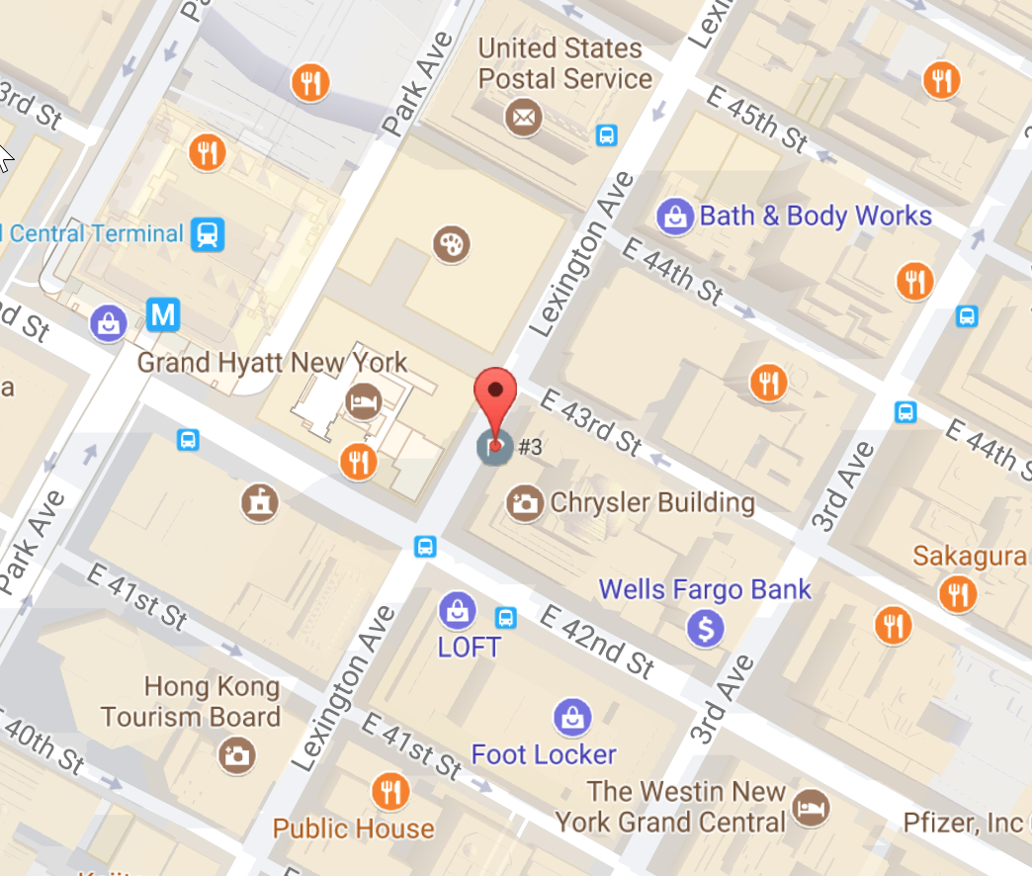
3. Business Owner perspective
#1 40th Street, Between Madison Ave and Park Ave
Question:
What is the ideal location to open a retail store based on traffic patterns?
Answer:
Based on clustering analysis, Top 3 street addresses are shown here →
#2 49th Street and Lexington Ave
#3 43rd Street and Lexington Ave

Slide 12

That’s All, Folks!
Links:
Main Article
Jupyter Notebooks
Prepare Data
Analyze from Tourist/Resident Perspective
Analyze from Cab Driver Perspective
Analyze from Business Owner Perspective
Github Repository

